Slide 1
Western Intake Partnership
Chatham County Conditional District Rezoning Request Public Hearing Presentation
January 16, 2024

Slide 2
Western Intake Partnership Regional Water Treatment Facility (RWTF)
Introductions
Items for Presentation
Project Purpose/Components
Vicinity Map
Concept for Raw Water Intake and Tunnel to RWTF
Preliminary Site Plan
Landscape/Planting Plan
Visual Impact (Renderings)

Slide 3
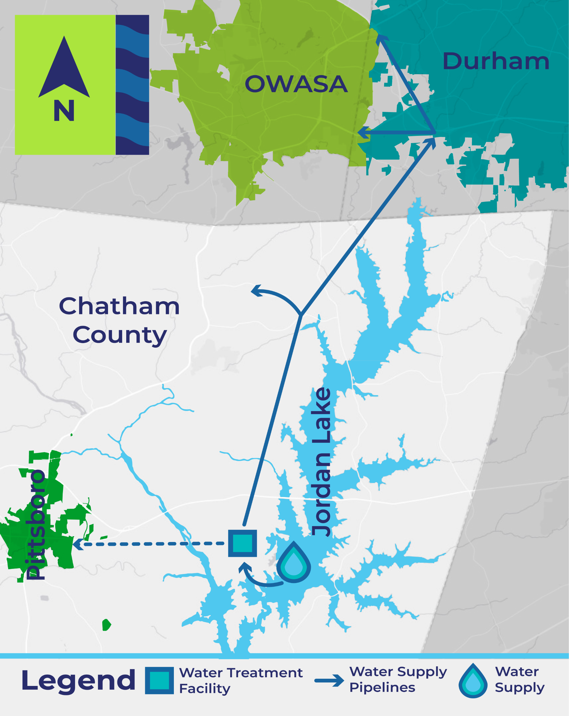
WIP Regional Water Treatment Facility (RWTF)
Western Intake Partnership (WIP)
Chatham County, City of Durham, Town of Pittsboro, OWASA
Current owner of RWTF site – OWASA
Project Purpose and Benefits
Construct a new surface water treatment facility to meet long-term water supply needs and access Partners’ Jordan Lake allocations
Benefits include public health and fire protection
Project Components
Jordan Lake Intake & Raw Water Pump Station/Pipeline to RWTF
New Regional Water Treatment Facility (initial capacity ~20 mgd, plans for future expansion)
Finished Water Transmission Pipelines (~16 miles initially)

Slide 4
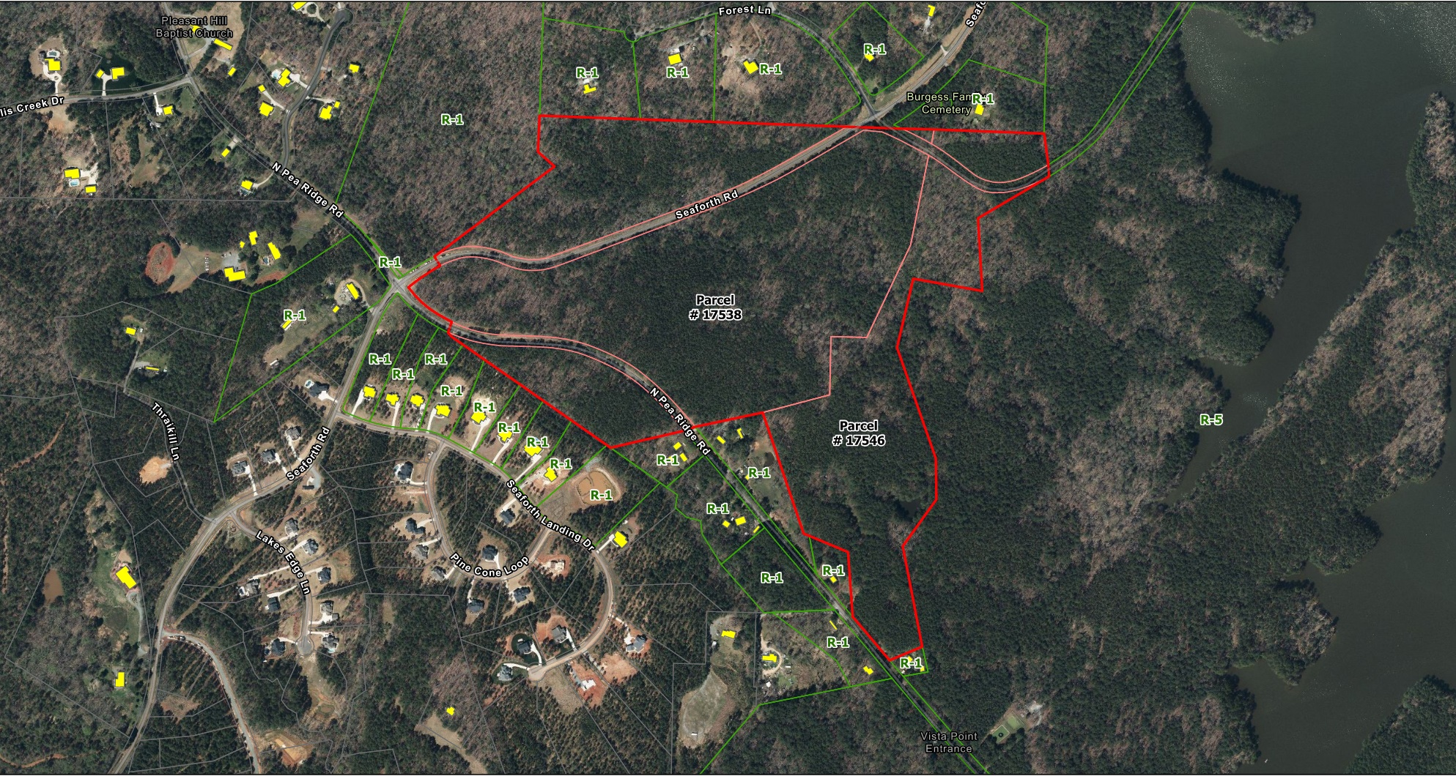
WIP RWTF Vicinity Map

Slide 5
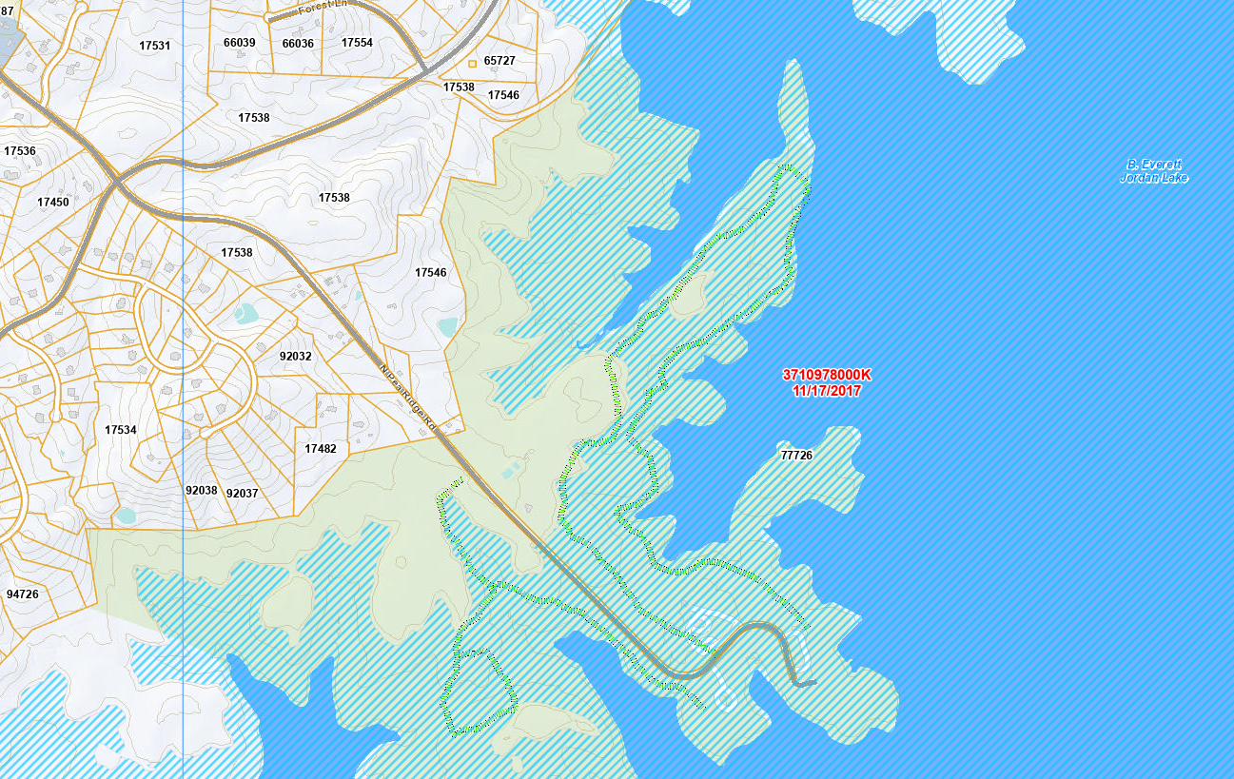
Concept for Raw Water Intake and Tunnel to RWTF
INTAKE
PUMP STATION
Tower Intake

Slide 6
What’s included in a Regional Water Treatment Facility?
~10-20 employees typical
Plant tours for student groups are common
2+ entrances
Fencing & gates
Physical security (CCTV cameras, key-card access for gates & buildings)
Emergency generators
Storage tanks for untreated and treated water
Treatment basins & facilities
Chemicals to treat the water
Disinfection process
Treated water (“finished water”) pump station
Facility to thicken, store & haul away solids/sediments from treatment process
Roads, stormwater management
Space for future expansion
Employee & visitor parking
Administration offices
Laboratory
Maintenance shop
Electrical power supply

Slide 7
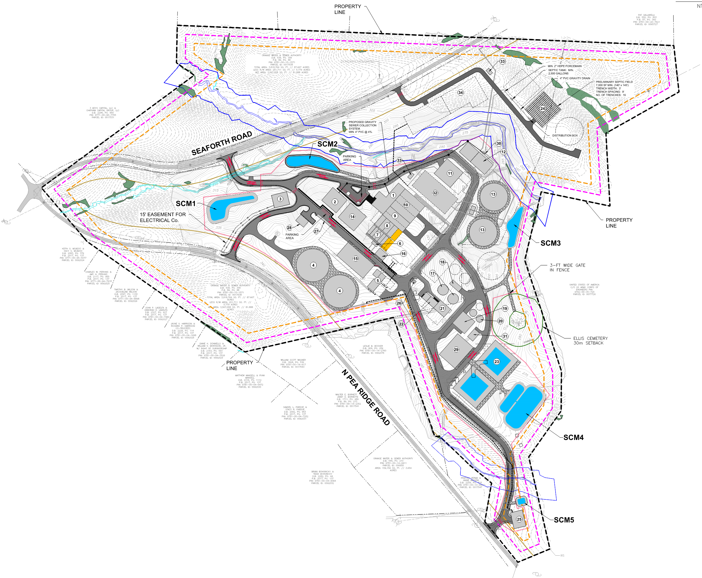
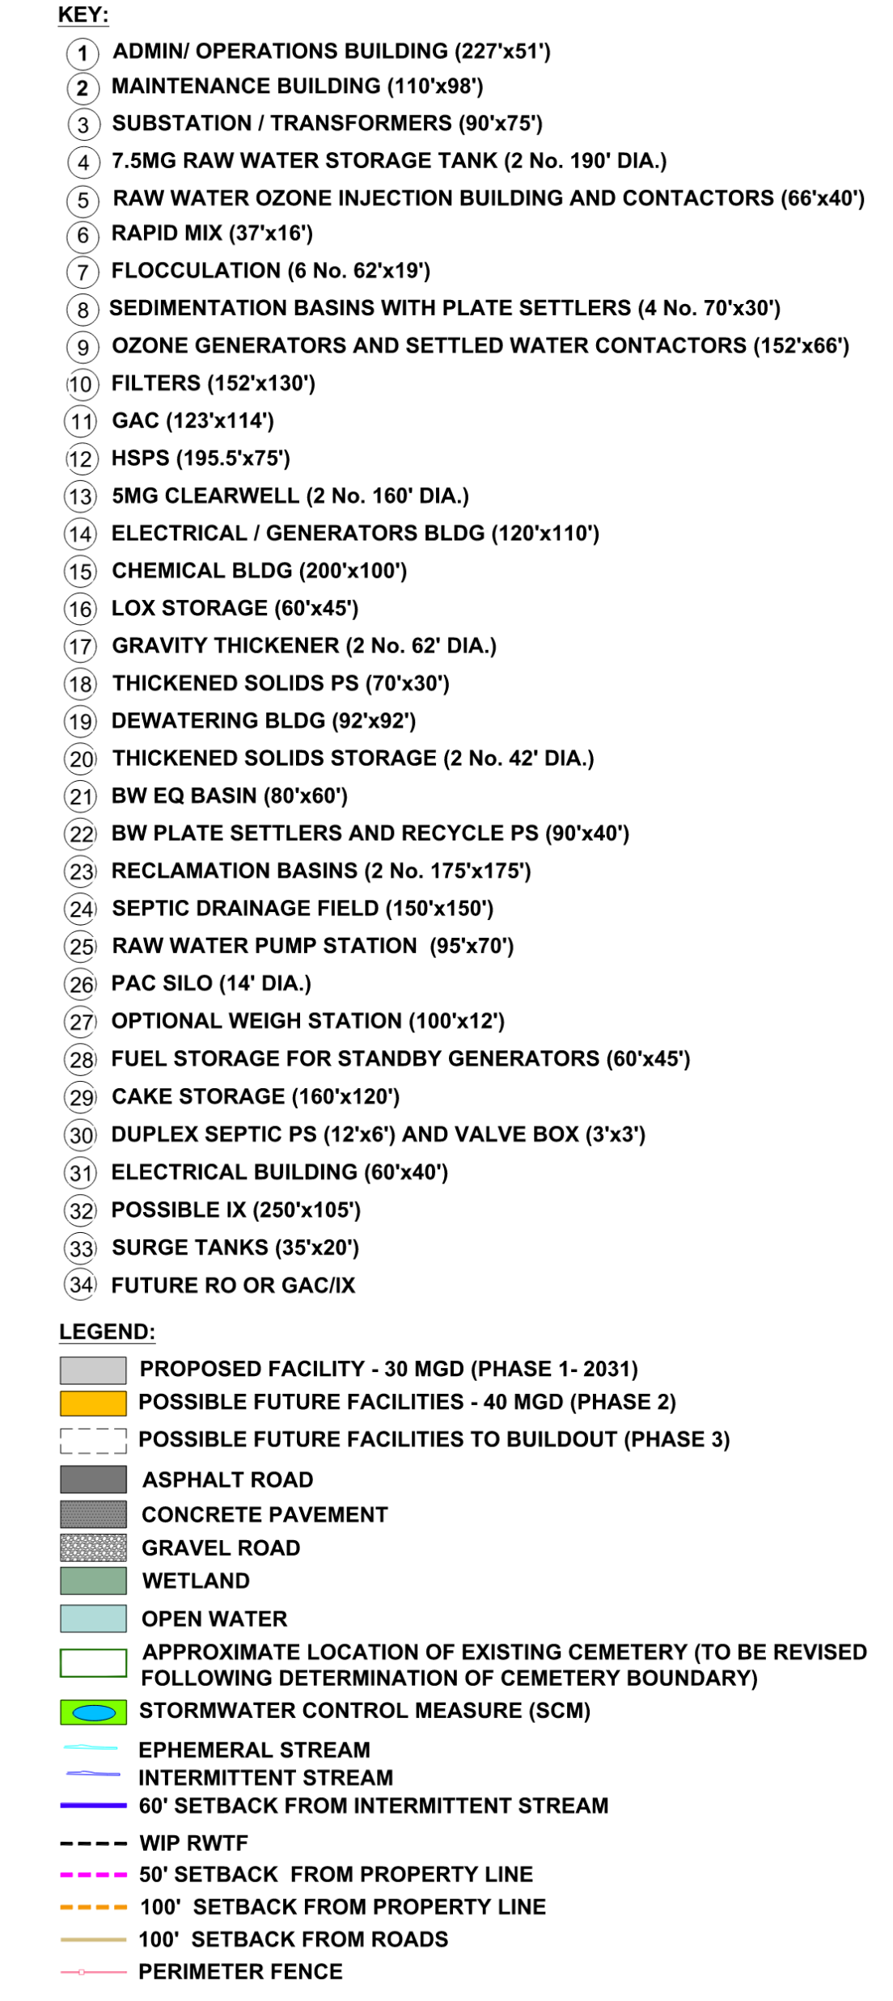
Preliminary Site Plan

Slide 8
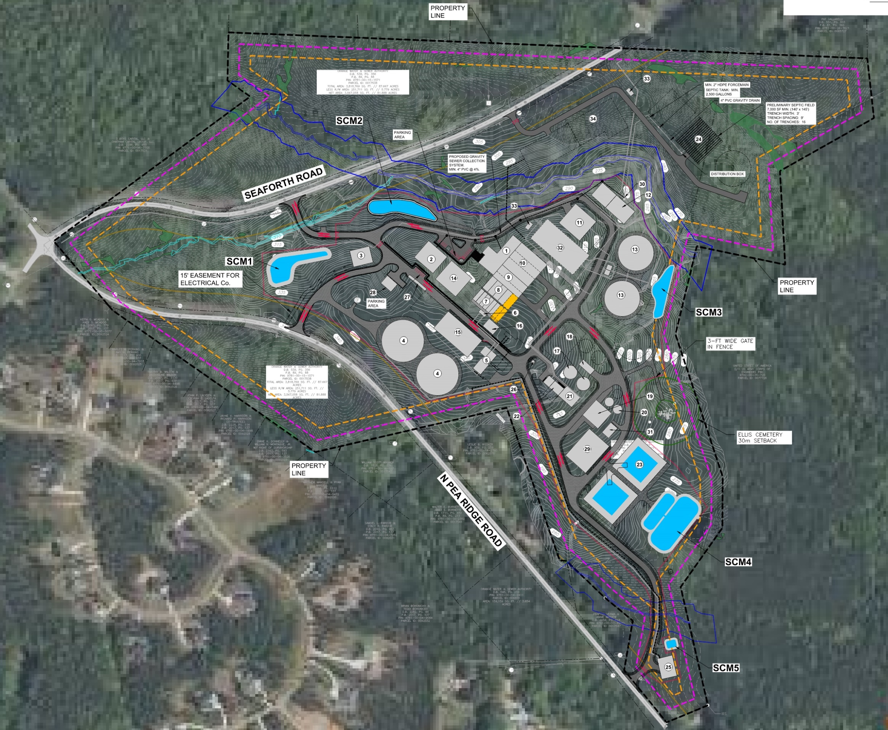
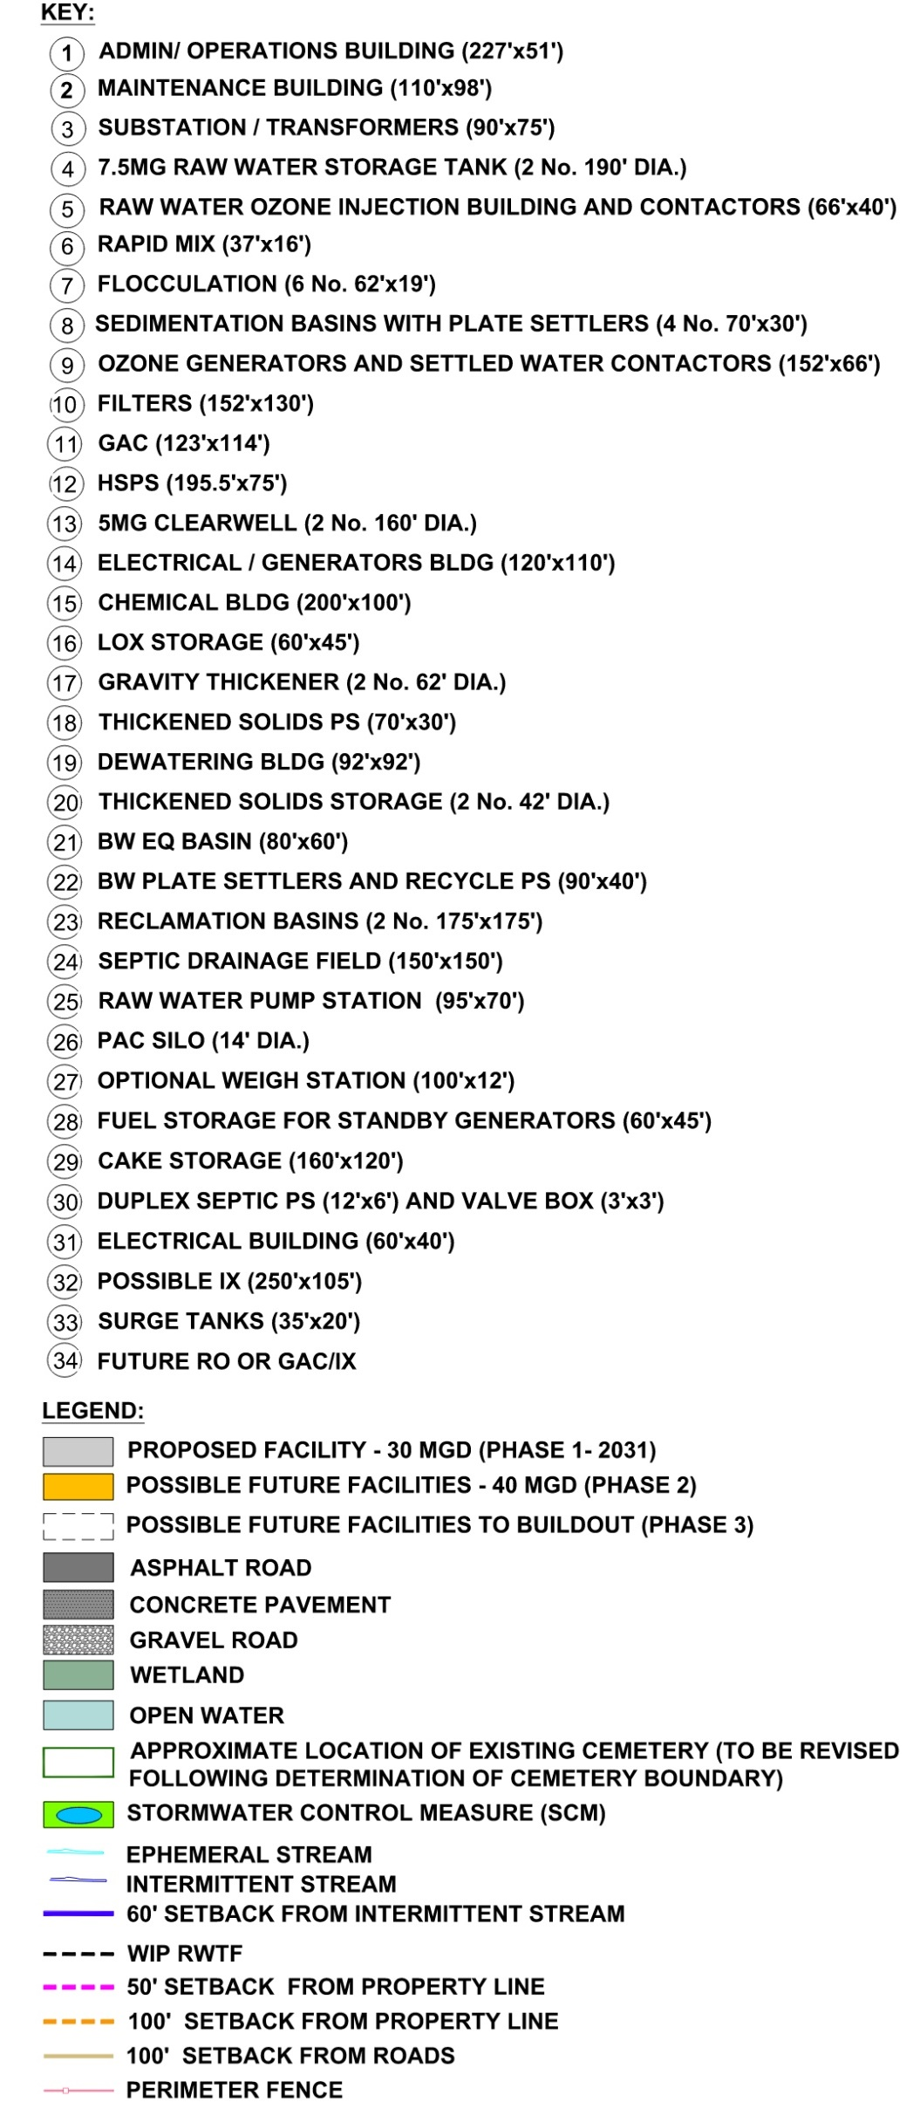
Preliminary Site Plan on Aerial

Slide 9
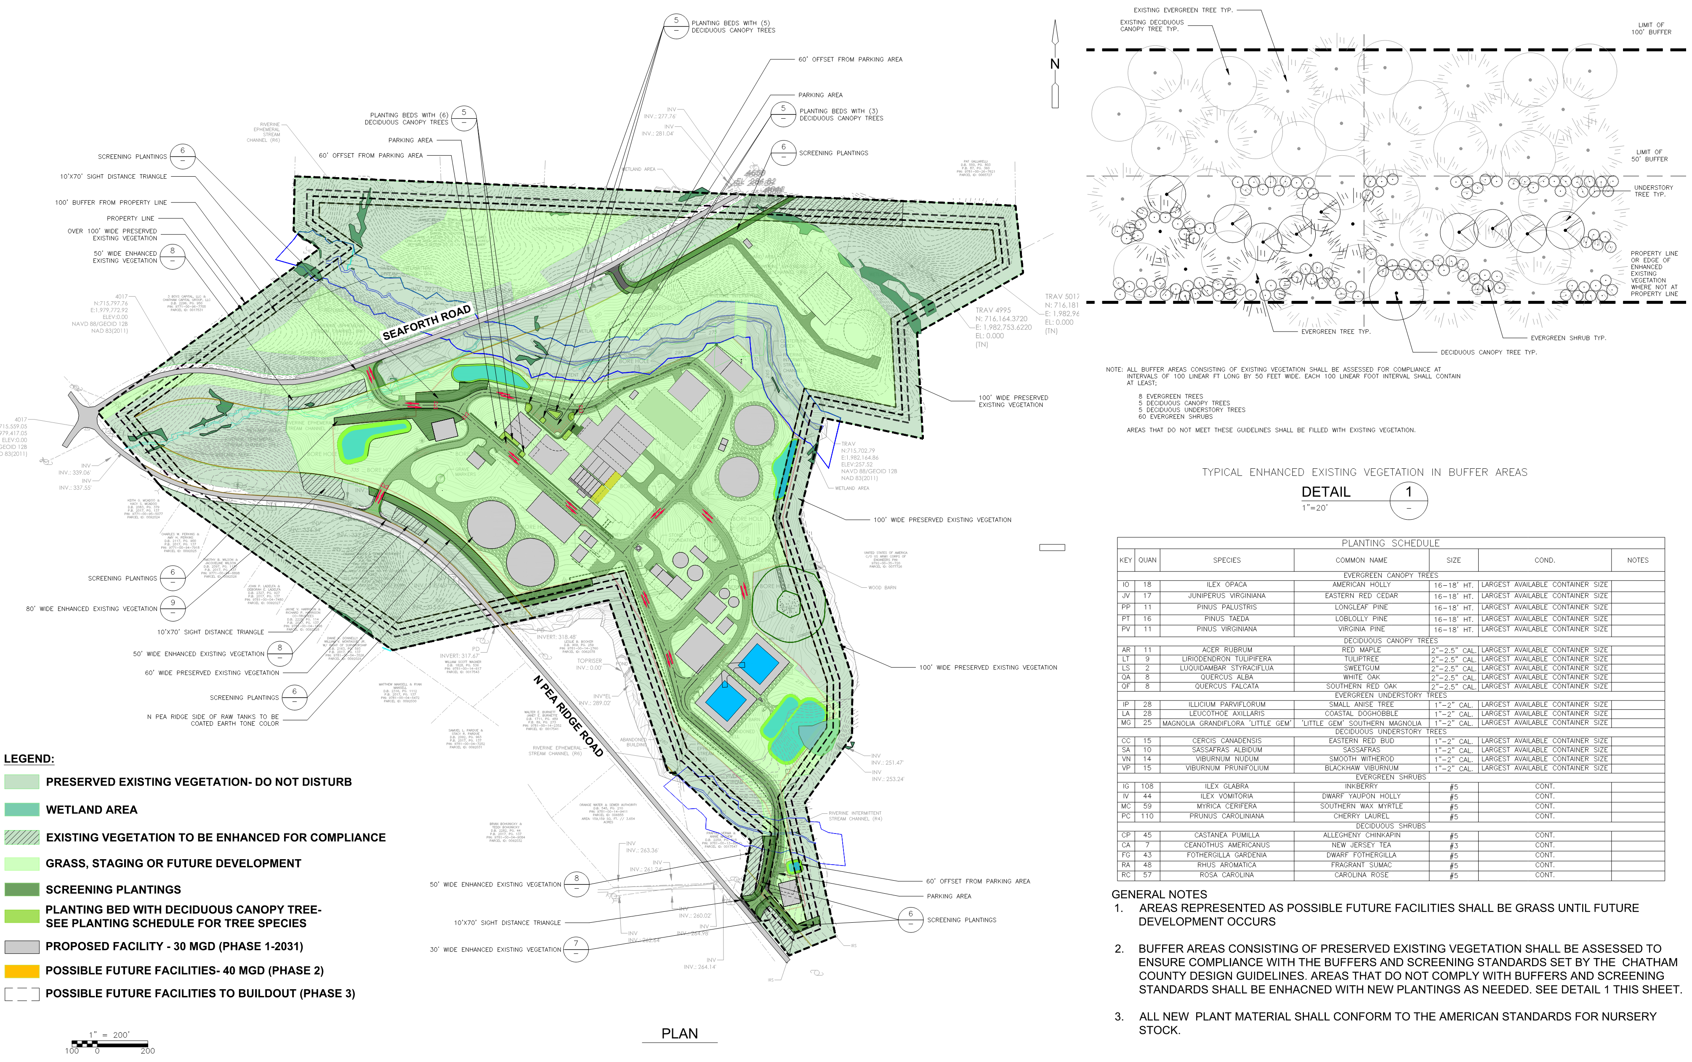
Preliminary Planting/Landscape Plan

Slide 10
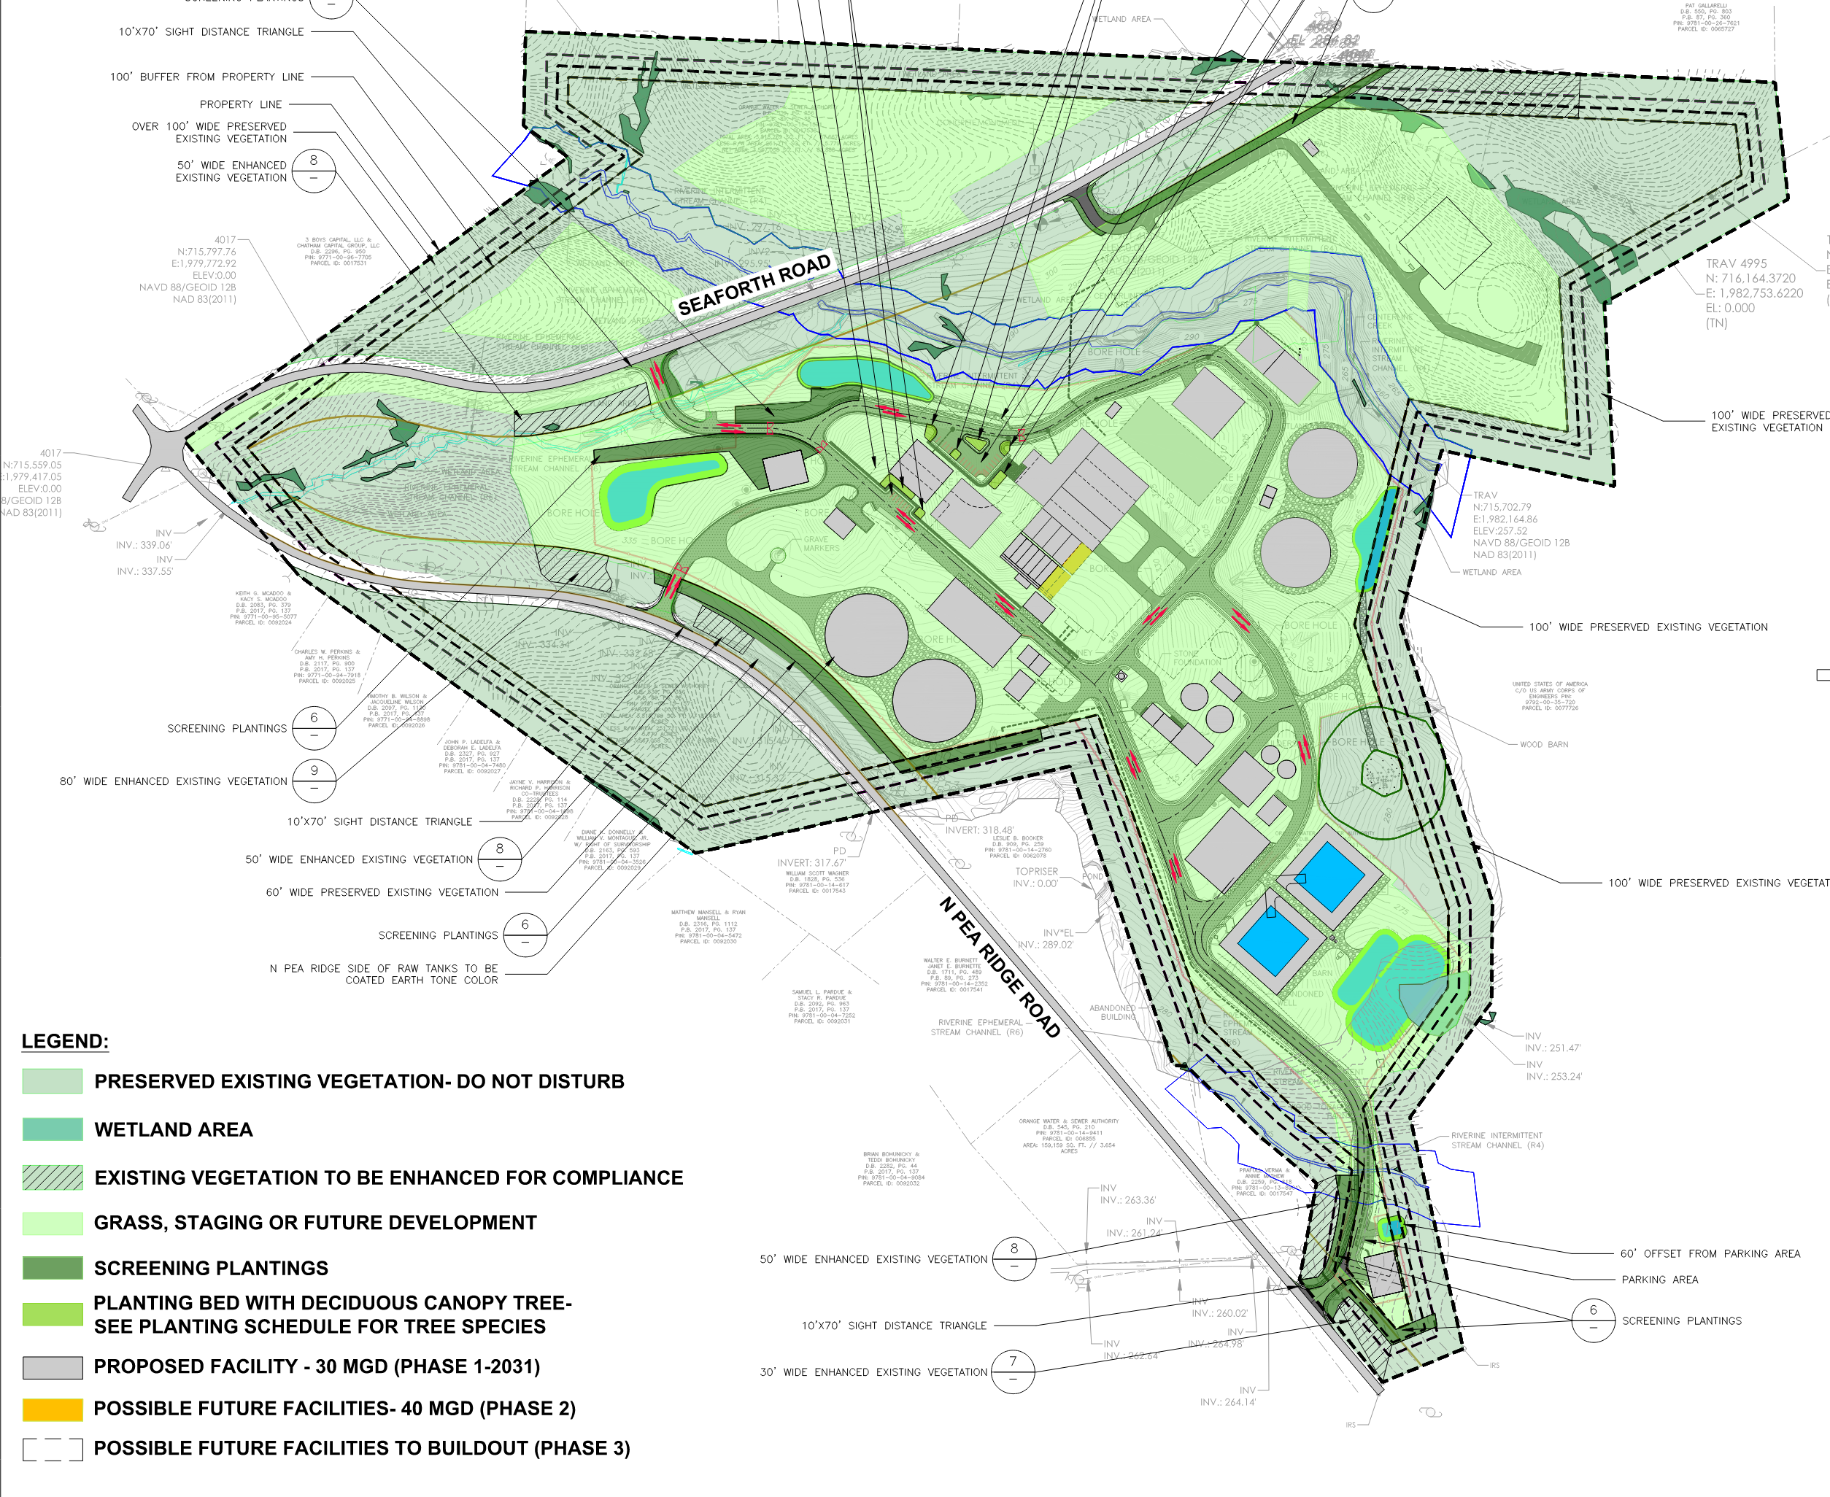
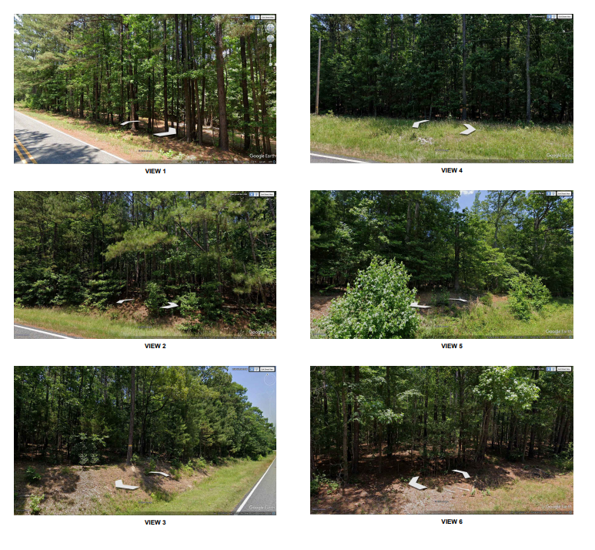
Preliminary Planting/Landscape Plan

Slide 11
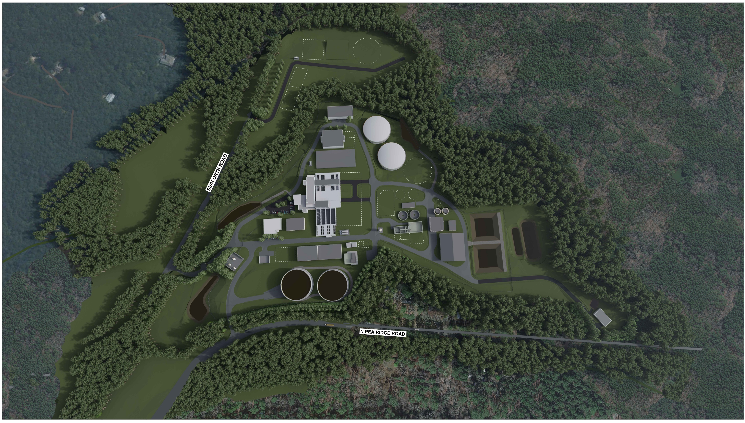
Aerial View of Preliminary Site Plan

Slide 12
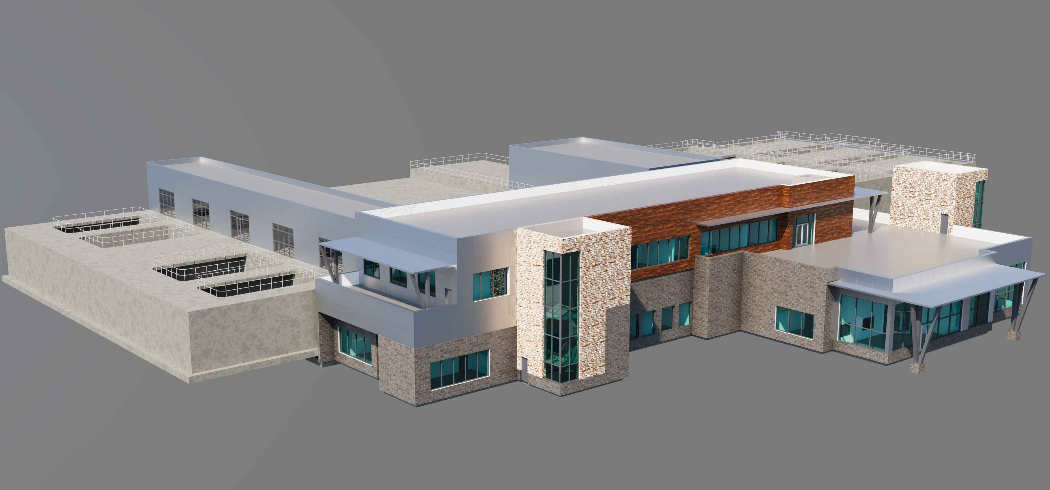
Tentative Operations Building Visual – Natural Aesthetic

Slide 13
Questions & Discussion

